Slide 1
Software project
Programming lab : 1211
Submitted to :
Ms. Anna Fariha Dr. Muhammad Asif Hossain Khan
Submitted by :
Abeda Sultana
Roll : 16
Nasid Habib Barna
Roll : 66

Slide 2

“FLUTTER”
This is a simple colorful game of flowers and butterflies.

Slide 3
Outline of presentation
1.Introduction
2.Features
3. Project goal 4. Project summary 5. Project features 6. How to operate 7. Implementation flow chart
8. Limitations 9. Some screenshots 10. Conclusion and future scope

Slide 4
Features
We used BGI ( Borland Graphics Interface) for graphic design.
The program is written in C language.
Microsoft Visual C++ 2010 is used for compiling.

Slide 5
Project goal
The goal of this project was to create a game using
the BGI library.
We have learnt a lot about graphics
Mainly we wanted to implement our knowledge in a practical case and have some fun.

Slide 6
Project summary
We implement our game in three level. In first level a flow of Colorful flowers will coming downward and the player has to click fixed colored flowers in a fixed duration of time.

Slide 7
Project Summary
In second level 4 flowers will be generated randomly and the player has to click sharply at the center of the flower.
The third level is inspired by the game ‘copter’ ,we just implement it in new graphical presentation in our own logic.

Slide 8
How to operate
LEVEL I : In 1st level, flowers are coming randomly in downward direction, we have to click on the light red colored flower to score. Click on pink flower will lead to game over. We have to attain at least 10 points in 15 second for completing 1st level.

Slide 9
How to operate
LEVEL II:
There are 5 rounds in this level. In each round randomly 4 flowers will be generated in the screen. One has to click on the center of at least 2 flowers.

Slide 10
How to operate
Level-III: We have to save the butterfly from the obstacles coming to its way and score more and more.

Slide 11
Implementation Flow chart
main()
dashboard()
instructions()
lvl1()
exit()
lvl2()
time()
leaves()
butterfly()
writename()
leaves1()
butterfly1()
lvl3()
butterfly3()

Slide 12
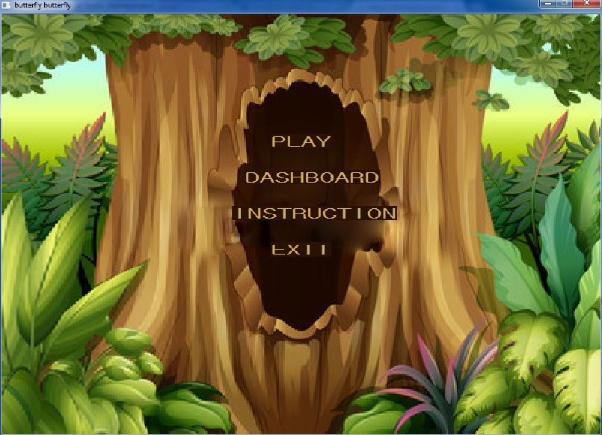
Screenshot of menu

Slide 13
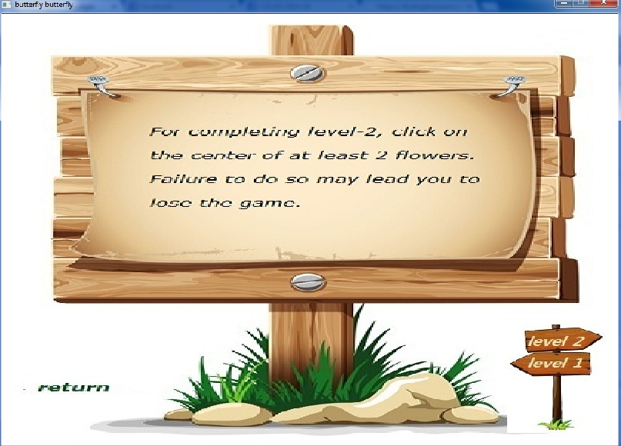
Screenshot of instruction

Slide 14
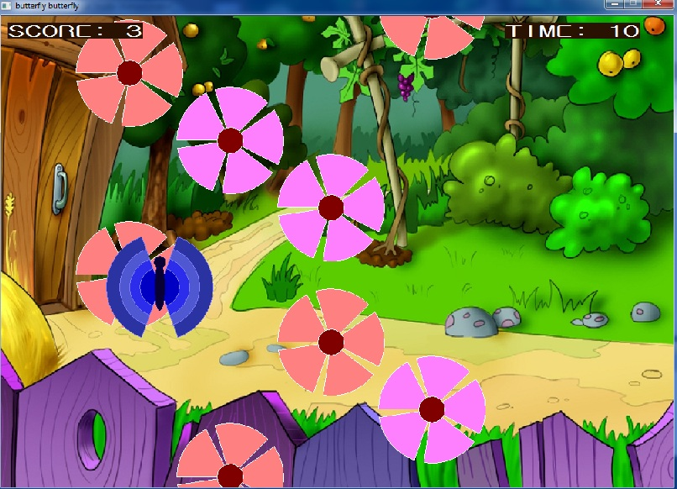
Screenshot of level-I

Slide 15
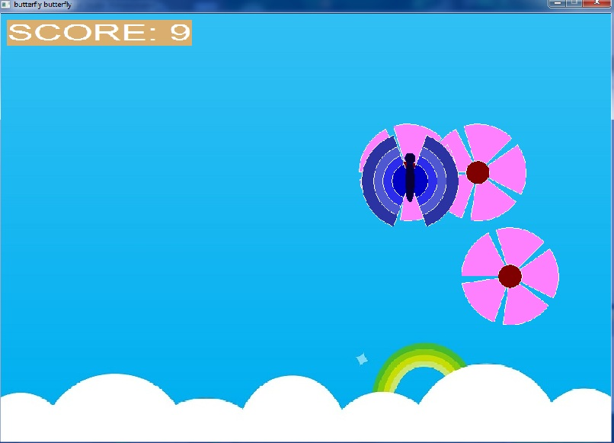
Screenshot of level-II

Slide 16
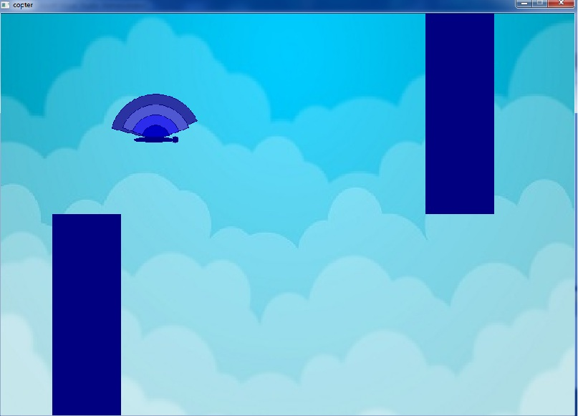
Screenshot of level-III

Slide 17
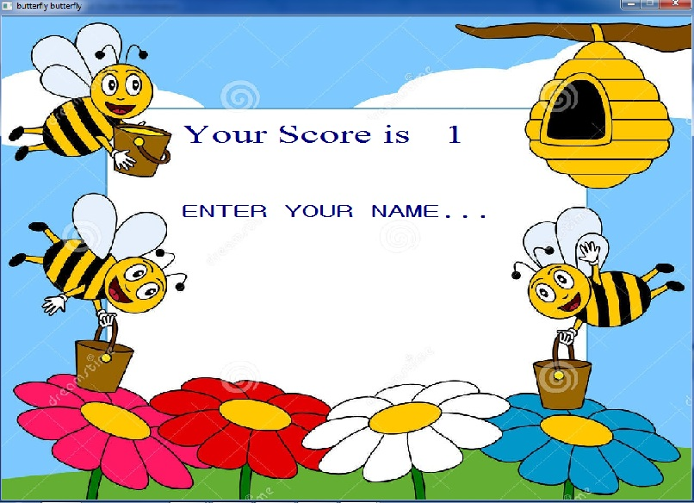
Screenshot of entering name for score

Slide 18
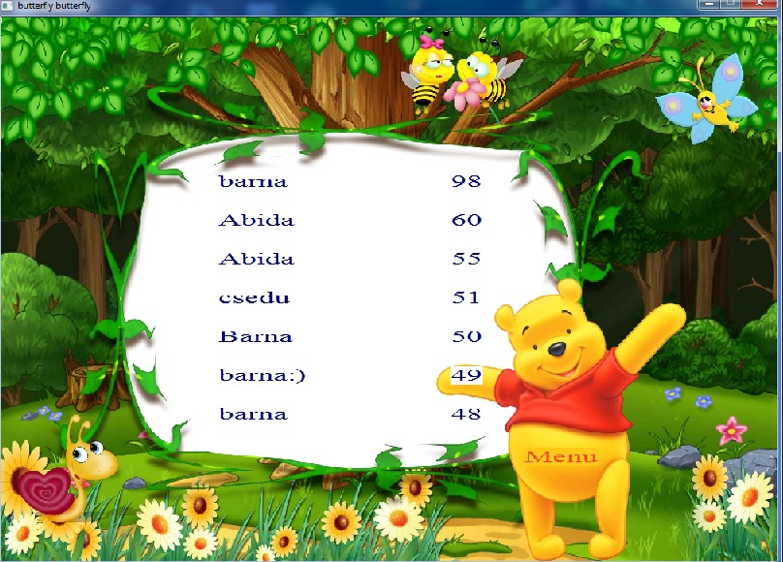
Leadership board

Slide 19
Limitations
With BGI function we couldn’t make the graphics attractive and delay () function sometimes doesn’t work properly so we had to face the screen blink.
In level 2 sometimes clicking on the flower’s center doesn’t make the flower disappear.

Slide 20
Conclusion and future scope
As our first software project, we have learnt a lot of things and working in graphics is really enjoyable. Though we couldn’t make the game perfect we hope we didn’t disappoint you that much.
In future we want to overcome the limitations and implement new ideas in it and we want to make it playable for every kind of devices.

Slide 21
THANK YOU…

